Slide 3
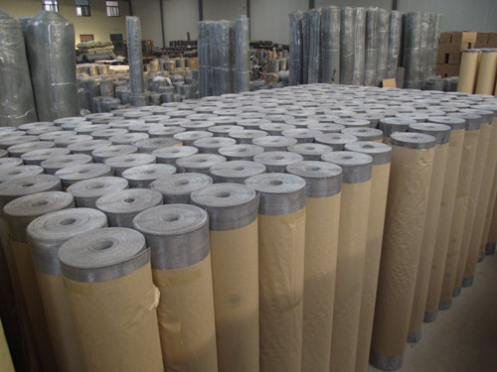
Aluminum window screen
Aluminium-magnesium alloy window screen is woven from aluminum
alloy wire containing magnesium, also known as "aluminium-magnesium
alloy window screen", "aluminum window screen", the color of aluminum
alloy window screen is silver white, corrosion resistant, suitable for use
in wet environment. Aluminum alloy window screen after coated with
epoxy resin paint, can be painted into black, green, silver gray,
yellow, blue and so on a variety of colors, so it is also called
"epoxy resin paint aluminum window screen".Aluminum alloy
window screen coated with epoxy resin paint is a high-grade
product, mainly sold to the United States, Europe and other
areas.

Slide 4
Aluminum window screen
Product name | Aluminum window screen
Material | Aluminium-magnesium alloy wire
Width | 0.5m—1.52m
wire diameter | 0.18-0.27mm
Specifications | 14*14mesh，16*14mesh，16*16mesh，18*16mesh，18*14mesh
Features | Good corrosion resistance
Colour | Black, green, silver-gray, yellow, blue

Slide 5
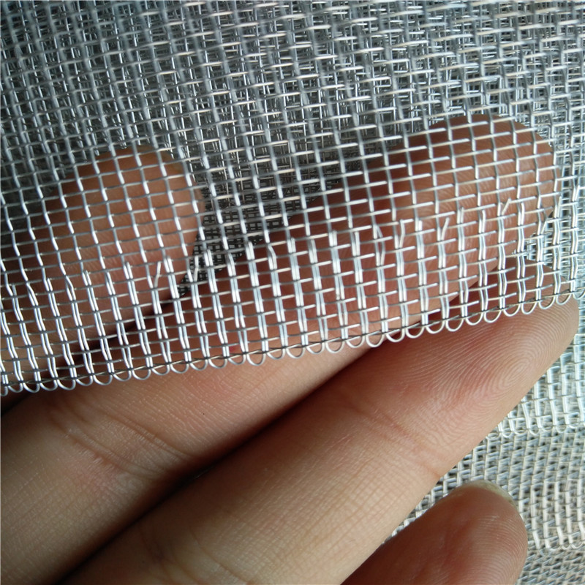
Product Details
GOOD PRICE
ODM/OEM
QUALITY FIRST

Slide 6
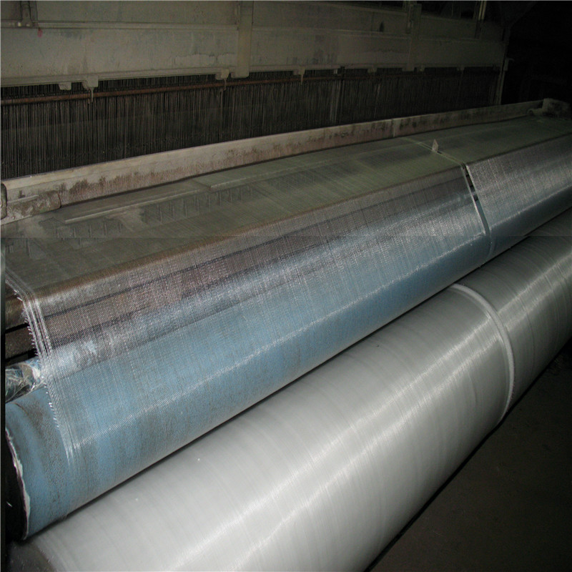
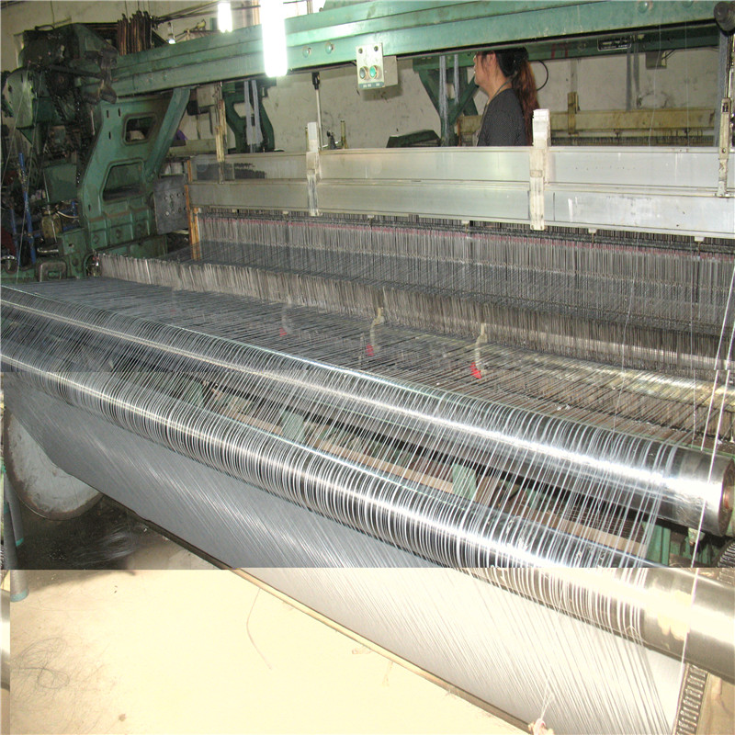
Production machine

Slide 7
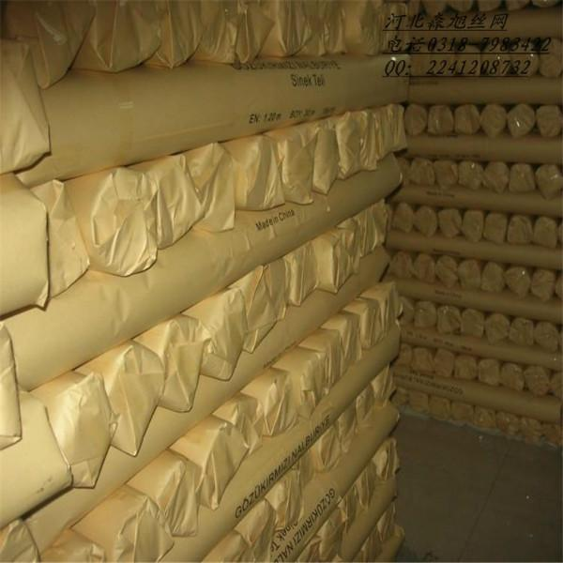
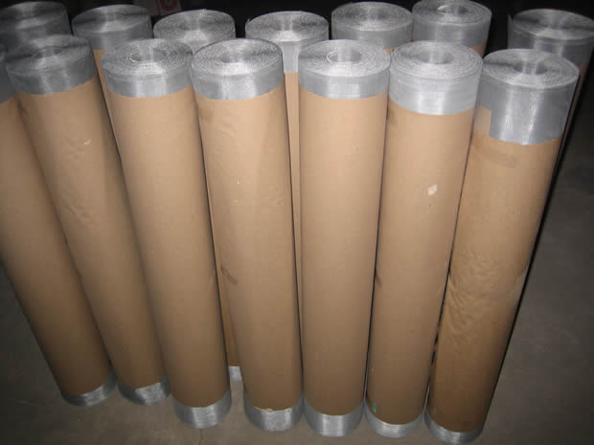
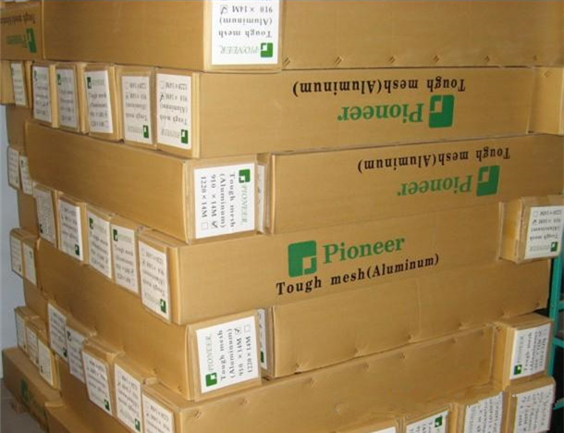
You can Choose different packaging

Slide 8
Production Application
Widely used in home decoration, mosquito prevention, building doors and Windows, all kinds of high-grade net cover receiving signal, etcidely
Also widely used in doors, Windows and corridors to prevent the disturbance of small insects
.

Slide 9
Fiberglass Window screen
Material: fiberglass yarn, coated with PVC, containing 65% plastic, fiberglass yarn 35%, fire resistance less than 5 seconds (International Standard)
Weaving and technology: fiberglass yarn was coated with pvc coating, then Plain weave, heating and shaping.
Characteristic：
It has excellent weather resistance, anti-aging, anti cold, anti inflammation, anti dry, anti moisture, fire retardant, anti-static, anti ultraviolet, tensile strength, long service life and so on.
The gauze mesh is uniform, and the warp and weft lines are vertical and horizontal, not to run and not to deform.
The light transmission performance is good, has the true sense of invisible effect.
non-toxic, tasteless, green environmental protection: our invisible window screen does not contain the atmosphere of harmful chlorine fluoride, which is in line with the ISO14001 international environmental certification requirements. So the use does not produce any harmful pollution to the human body.
Product application
Application for all sorts of airy in salvation an preventing insect and mosquito. It is widely used in construction, orchard, ranch etc.
We can make the size, color and mesh of windows screen according to the customer.

Slide 10
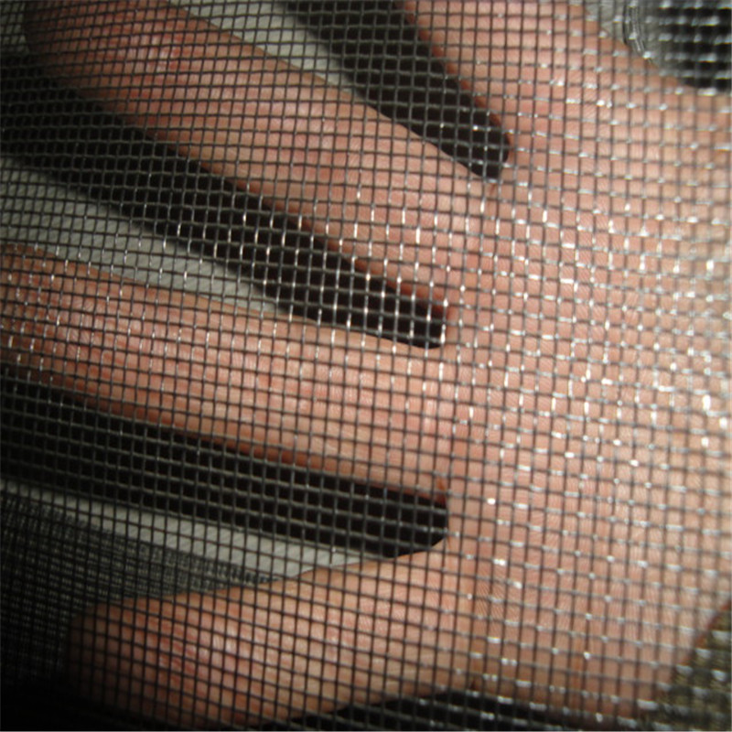
Product Details
Material | Mesh Size | Width | Length
%35 Fiberglass %65 PVC | 16x14, 16x16, 16x18, 18x14, 18x18, 20x20 | 24cm-280cm | 20-30m
Heat proof | Wire diameter | Colors | g/ m2
-36 C, + 125 C | 0.25±0.03 mm | Black, Gray, White, Green | 90-120

Slide 11
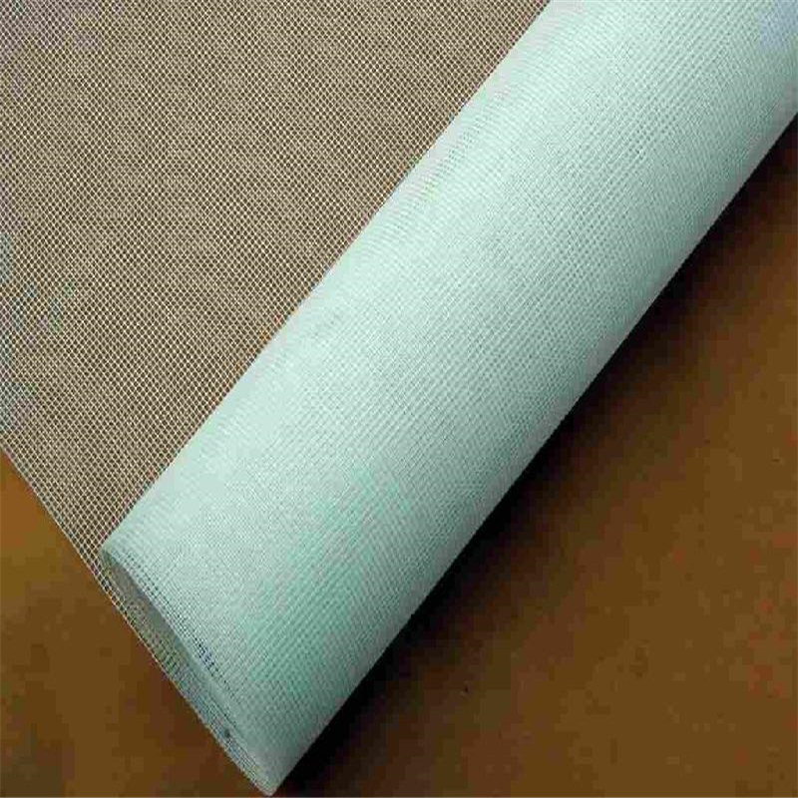
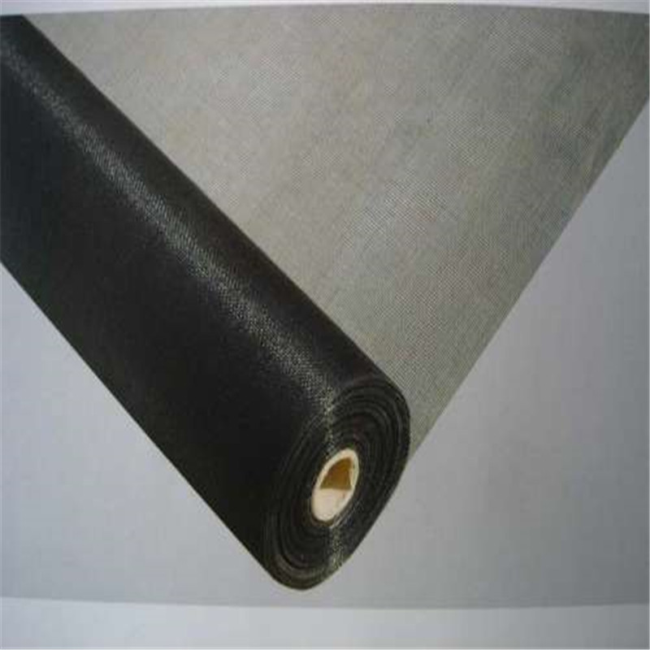
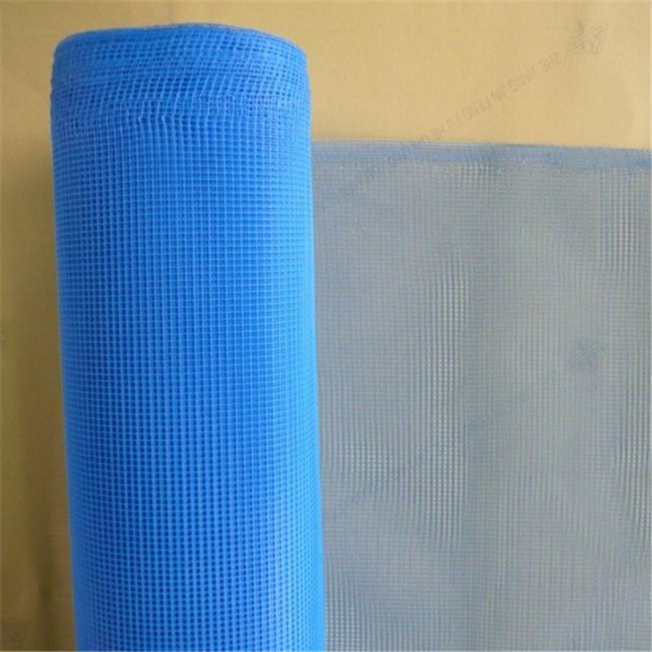
Different Colors
available

Slide 12
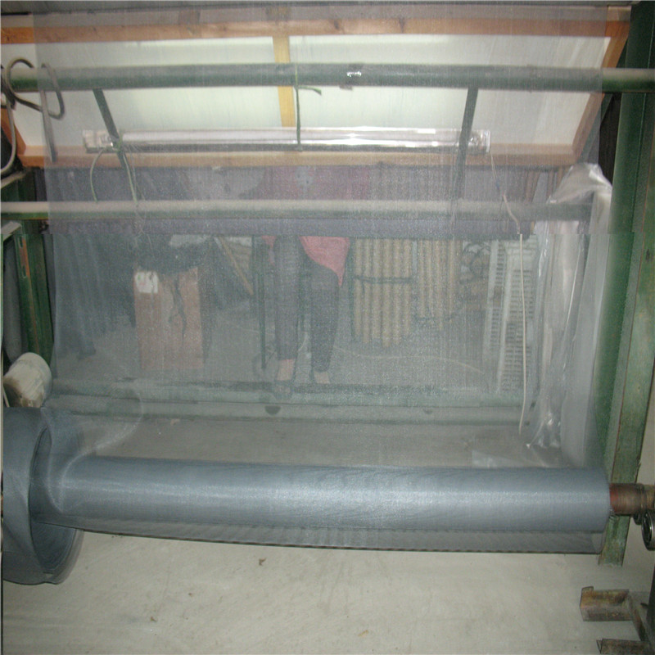
Production Machine

